Slide 1


BABY SHALINI PADAKANDLA
IBM (CYBER SECURITY)

Slide 2
STUDENT DETAILS
Name : BABY SHALINI PADAKANDLA
Email Id : haribabylakshmi@gmail.com
Interns : IBM
Internship Domain : Cyber Security
College Name : RISE Krishna Sai Gandhi Group of Institution
College State : Andhra Pradesh
Internship Date : 07/06/2023 to 15/07/2023

Slide 3
PROJECT TITLE/PROBLEM STATEMENT
Project Title : DOS( DENIAL OF SERVICE ) ATTACK USING NS2
Problem Statement :
Attack model and HHT analysis method
Spark-based correlation coefficient computing false components eliminations
Understanding the impact of dos attacks on network security
Dos attacks pose a significant threat to network security, causing system downtime and compromising user experience.
The objective is to explore the various types of DOS attacks and develop effective counter measure to mitigate their impact.
Lack of knowledge and awareness regarding DOS attacks can lead to server consequences for individuals and organizations.

Slide 4
AGEND
The main aim of the project is to install NS2 (Network simulator version 2) and NAM (Network Animator) in ubuntu Operating system.
After the we create a network topology and generate TCP( Transmission Control protocol)
and UDP (user Datagram protocol) traffic.
In final phase we perform DOS attack on network simulator.
providing an overview of DOS attacks, their characteristics, and potential.
identifying the end end users affected by DOS attacks and their vulnerabilities.

Slide 5
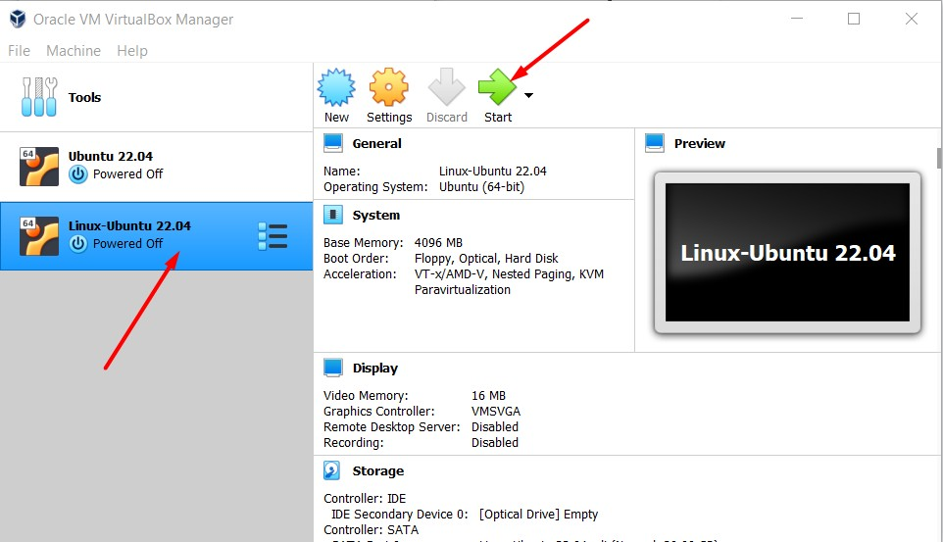
PROJECT OVERVIEW
In this project we need to install the Network Simulator Version 2 and Network Animator
First before installing the both we need to install ubuntu I have been installed LINUX but based on system install the version and operating system.

Slide 6
PROJECT OVERVIEW
In the command box of ubuntu command to install the NS2 in system
Nam is a TCL/TK based animation tool for viewing network simulation traces and real world packet traces. It supports topology layout, packet level animation, and various data inspection tools.
Install it by running the command in the terminal:
sudo apt-get install -y nam

Slide 7
PROJECT OVERVIEW
After the command we need to check correctly installed or not :
By some command
Create a file:
gedit add.tcl
Paste the following code in the file:
set a 20
set b 30
set c [expr $a+$b]
puts $c
C. Run in the terminal using ns2:
ns add.tcl

Slide 8
PROJECT OVERVIEW
After checking the installment of the NAM
Create a network topology and generate TCP and UDP traffic then
#Create a simulator object
set ns [new Simulator]
#Define different colors for data flows (for NAM)
$ns color 1 Blue
$ns color 2 Red
#Open the NAM trace file
set nf [open out.nam w]
$ns namtrace-all $nf

Slide 9
PROJECT OVERVIEW
Set up the TCL after the simulator
#Setup a TCP connection
set tcp [new Agent/TCP]
$tcp set class_ 2
$ns attach-agent $n0 $tcp
set sink [new Agent/TCPSink]
$ns attach-agent $n3 $sink
$ns connect $tcp $sink
$tcp set fid_ 1
#Setup a FTP over TCP connection
set ftp [new Application/FTP]
$ftp attach-agent $tcp
$ftp set type_ FTP

Slide 10
PROJECT OVERVEIW
Set up UDP after the TCL
#Setup a UDP connection
set udp [new Agent/UDP]
$ns attach-agent $n1 $udp
set null [new Agent/Null]
$ns attach-agent $n3 $null
$ns connect $udp $null
$udp set fid_ 2
#Setup a CBR over UDP connection
set cbr [new Application/Traffic/CBR]
$cbr attach-agent $udp
$cbr set type_ CBR
$cbr set packet_size_ 1000
$cbr set rate_ 1mb
$cbr set random_ false

Slide 11
PROJECT OVERVIEW
Schedule the CBR and FTP
#Schedule events for the CBR and FTP agents
$ns at 0.1 "$cbr start"
$ns at 1.0 "$ftp start"
$ns at 4.0 "$ftp stop"
$ns at 4.5 "$cbr stop"
#Detach tcp and sink agents (not really necessary)
$ns at 4.5 "$ns detach-agent $n0 $tcp ; $ns detach-agent $n3 $sink"
#Call the finish procedure after 5 seconds of simulation time
$ns at 5.0 "finish"
#Print CBR packet size and interval
puts "CBR packet size = [$cbr set packet_size_]"
puts "CBR interval = [$cbr set interval_]"
#Run the simulation
$ns run

Slide 12
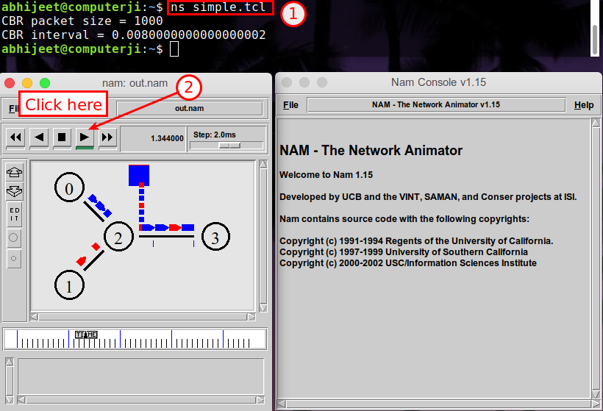
PROJECT OVERVIEW
Run the simulation from the terminal using ns2 : ns simple.tcl
Click on the play button to start the simulation:

Slide 13
WHO ARE THE END USERS
A denial-of-service (DoS) attack is a cyberattack on devices, information systems, or other network resources that prevents legitimate users from accessing expected services and resources.
End users of the DOS attacks in the some examples:
Financial data (business and customer)
Sensitive personal data
Customer databases, including personally identifiable information (PII)
Email address and login credentials
Intellectual property, such as trade secrets and product designs
IT infrastructure access
U.S. government departments and agencies

Slide 14
SOLUTION AND IT VALUE
The Solution is to prevent the DOS Attack from Cyber Attackers.
Preventing a DoS attack can be challenging, but there are several effective techniques:
Network segmentation: Segmenting networks into smaller, more manageable pieces, can limit the impact of a DoS attack.
Load balancing: Distributing traffic across multiple servers, a DoS attack can be prevented from overwhelming a single server or resource.
IP blocking: Blocking traffic from known or suspected malicious sources can prevent DoS traffic from reaching its target.
Rate limiting: Limiting the rate of traffic to reach a server or resource can prevent a DoS attack from overwhelming it.
Content Delivery Networks (CDNs): Distributing website content across multiple locations makes it more difficult for an attack to bring down an entire site.

Slide 15
SOLUTIONS AND ITS VALUES
By operating system has a unique and reliable way to protect devices from DoS.
Value proposition for DOS Attack stands as a promise by a company to a customer or market segment by preventing them from Cyber Attacks. The proposition is an easy-to-understand reason why a customer should buy a product or service from that particular business.

Slide 16
HOW TO COUTOMIZE THE PROJECT
We customize the project for easy way to prevent the DOS Attack & secure the computer network devices.
The Cyber Attackers main purpose is to attack the systems and stole the sensitive information from our devices then blackmailing & demand so much of payment.
So, our implementation may stop the DOS Attacks from the Attackers in Business Environments.

Slide 17
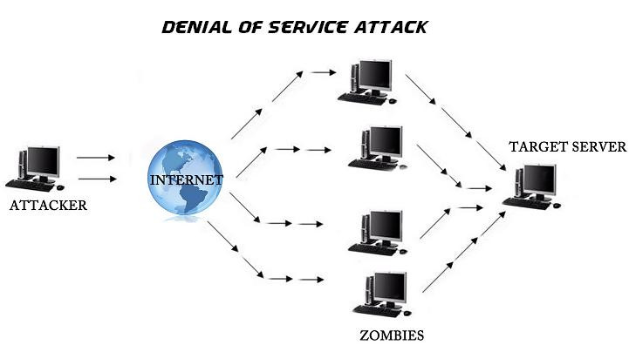
MODEL OF DOS ATTACK

Slide 18
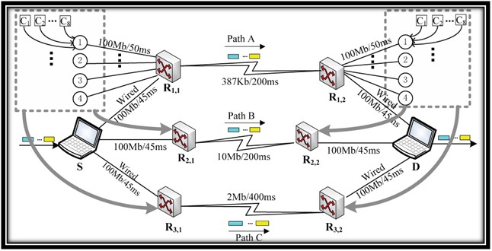
MODEL OF DOS ATTACK USING NS2

Slide 19
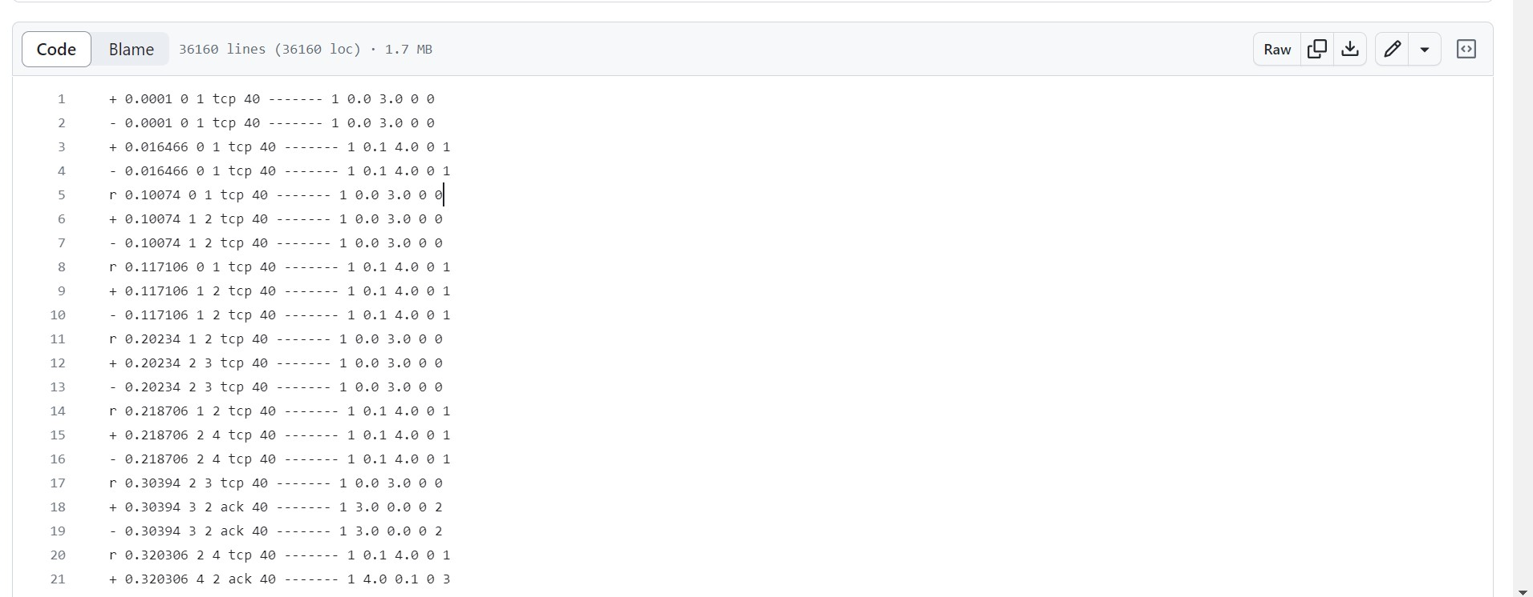
DOS OUTPUT

Slide 20
RESULT
We check the Network Traffic at final phase in Simulator for transferring the packets in a queue manner. The Packets will add to Queue for data transfer in First - In - First - Out manner. The packet transfer will be completed then packet are removed from queue.
The network traffic resulted in both .nam(Network Animator) & .tr(Trace) file.
The successful results are provided below in GitHub Repository:
DOS Attack Output in .nam file:
https://github.com/baby10shalini/baby10shalini/commit/4e3174f50aceb36a7d499814c75c339d3eaca113#diff-bdfbac132682e716c1cf17a99807d668daec7e0414d0e6f95ca1f2c0ca5a6141

Slide 21
LINKS
https://github.com/baby10shalini/baby10shalini/tree/dos-attack
https://drive.google.com/file/d/12B2gPkh33QL-Lf6jW0hYKYd1vjdGZEW-/view?usp=drivesdk
Stable code output link here

Slide 22
THANK YOU

